Slide 1
RAG
CHALLENGE
Diego Rosa Paz
Sylvia Y. Pérez Montero
2/7/2025

Slide 2

Gutenberg Data
15,000 eBooks sourced from Project Gutenberg, an online library of public domain ebooks.
This project was founded in 1971 by the inventor of ebooks, Michael S. Hart.
From this dataset we mainly worked on a smaller subset of 500 entries. While also limiting the character size to 5000 to stay within gpt-4’s token limits.

Slide 3
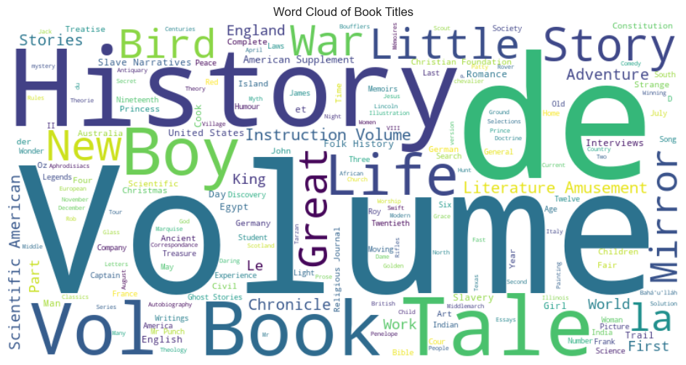

Slide 4
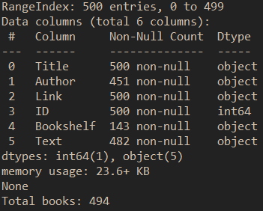
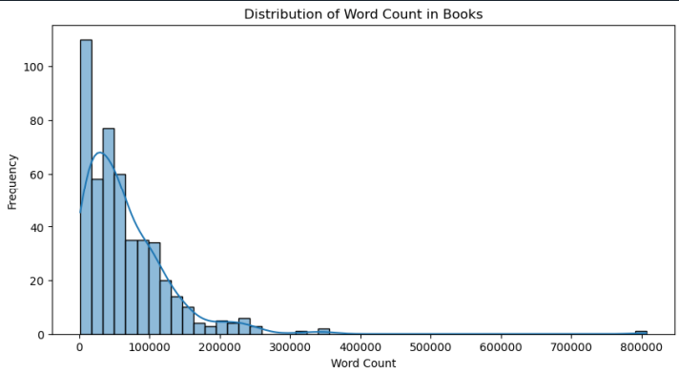
After some initial EDA, the dataset was appended with embeddings create by convert the contents of ‘Text’ it into a tensor.
These embeddings were then stored with ChromaDB. Ready to be used in a RAGs pipeline with a all-MiniLM-L6-v2 sentence transformer.

Slide 5

RAGs Pipeline

Slide 6
Querying
# Different contexts provided:
# 1. "You are a helpful assistant."
# 2. "You are a librarian with intimate knowledge of this catalogue. Draw on examples from your catalogue."
test_queries = [
"What are the main themes in some of Victor Hugos works?",
"Summarize a book written by Zane Grey.",
"Briefly summarize Disturbing Sun.",
"What are some of the works written by Anonymous in your catalogue?"
]

Slide 7
Responses
Query: Summarize the a book written by Zane Grey in 3 sentences or less.
Assistant
Librarian
"The U.P. Trail" by Zane Grey is a historical novel showcasing the construction and impact of the Union Pacific Railroad across the American wilderness and the various cultures it intersects. The narrative explores vivid landscapes, cultural contrasts, and the human struggle as it maps the railroad's path from Missouri to California. Simultaneously, it encapsulates the fierce vibrancy of the era, including encounters with savage tribes, lawless cities, diverse characters, and the overall transformation of a country.
"The U.P. Trail" is a novel by Zane Grey that vividly brings to life the dramatic adventure and hardships faced during the construction of the Union Pacific Railroad in the untamed American West of the nineteenth century. The setting ranges from the vast landscapes of Nebraska to the daunting peaks of Wyoming, passing through Utah's diverse terrains and finally reaching the sweeping panoramas of California. It illuminates the interactions between different cultures, the lawlessness, and ever-present danger, as well as the spectacular natural beauty of the landscapes in this transformational era of American history.

Slide 8
Responses
Query: Briefly summarize Disturbing Sun in 3 sentences or less.
Assistant
Librarian
"Disturbing Sun" is a science fiction novel by Robert Shirley Richardson, unveiled through the format of an interview with Dr. I. M. Niemand. Here, Dr. Niemand shares his profound investigation about the correlation between the Sun's activity, particularly sunspots, and various terrestrial activities. He argues that human evil might not stem from inherent nature, but rather from influences of the Sun, breaking conventional perspectives.
"Disturbing Sun" is a science fiction e-book by Robert Shirley Richardson, produced by Greg Weeks, Bruce Albrecht, Mary Meehan, and the Online Distributed Proofreading Team. The narrative involves a fictional interview with Dr. I. M. Niemand, the Director of the Psychophysical Institute of Solar and Terrestrial Relations, exploring the effects of the sun's activities, such as sunspots, on Earth. The work specifically delves into the unproven theory that solar activities may impact human behavior and potentially drive human evil.

Slide 9

One last rag

